Slide 1
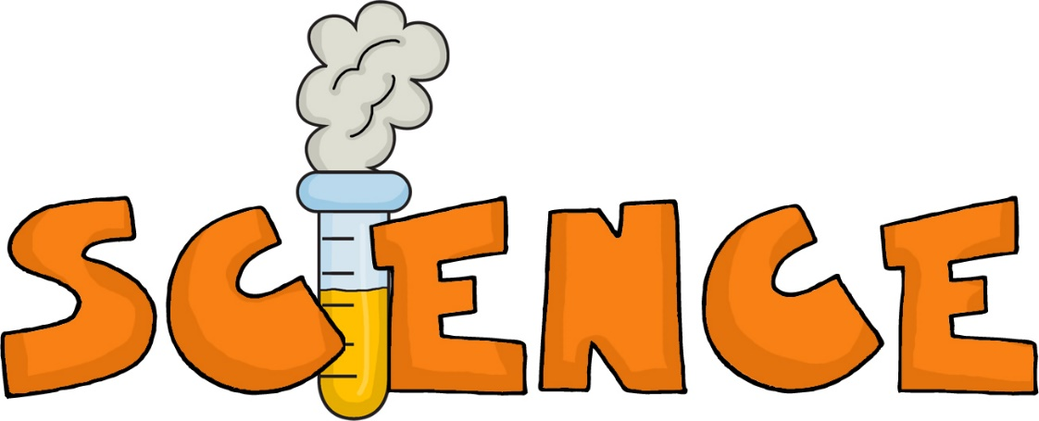
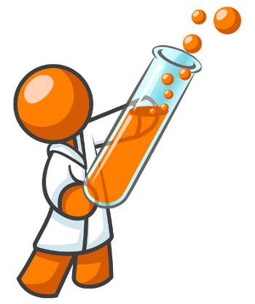
4th Grade
Milestone Review
CFA #11

Slide 2
Milestone Review
GPS
Whitetail deer live on the Cumberland Island National Seashore. What would make the deer population on the island smaller?
A
people moving away from the island
B
planting new trees in the forest area where old
ones were cut
C
building ponds in some of the island clearings
D
introducing grey wolves to the island

Slide 3
Milestone Review
GPS
2. An animal that eats only plants is
called
A
a herbivore
C
a carnivore.
an omnivore
a scavenger.
B
D

Slide 4
Milestone Review
GPS
3. Which of the following would
probably cause the MOST harm
to a pond or stream?
A
removing plants from along the banks
B
introducing a new species of fish to the water
C
piping in sewage from a nearby neighborhood
D
building floodgates to control the water's height

Slide 5
Milestone Review
GPS
4. Which characteristic is NOT an
example of protective adaptations?
A
presence of an exoskeleton in a lobster
camouflage of the walking stick insect
B
C
presence of long running legs in the ostrich
well-developed circulatory system of a sparrow
D

Slide 6
Milestone Review
GPS
5. The number of predators in a
community depends on what
factor?
A
the number of prey
the amount of sunlight
B
C
the amount of rainfall
.
the number of decomposers
D

Slide 7
Milestone Review
GPS
6. What does pollution in streams and
lakes usually do to the plants and
animals that live there?
A
helps them grow
creates water
B
C
gives them food
kills them
D

Slide 8
Milestone Review
GPS
7. A grasshopper is an insect that is
light green in color. Birds like to eat
grasshoppers. Grasshoppers
would be safest on
A
blades of grass.
flower petals.
B
C
the bark of trees.
wooden fence posts.
D

Slide 9
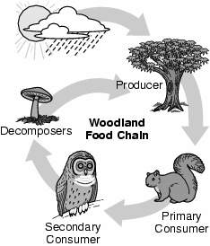
Milestone Review
GPS
8. What do decomposers, such as the mushroom,
do in the food chain?
A
produce their own food
B
eat both plants and animals
C
eat only old leaves that have fallen off the tree
break down dead materials and return them to the soil
D

Slide 10
Milestone Review
GPS
9. A producer is a living thing that
makes its own food from sunlight.
Which of the following is a producer?
A
human
B
bee
C
cow
corn plant
D

Slide 11
Milestone Review
GPS
10. Use the table below to answer this
question.
In Year 1, there were 600 animals living in a rain forest. In Year 2, people started cutting down trees, and then there were 400 animals. In Year 3, people kept cutting down trees. Which is the BEST prediction for the number of animals left in the rain forest in Year 3?
A
more than 600
C
400
600
less than 400
B
D

Slide 12
Milestone Review
GPS
11. Beavers have webbed feet and
paddle-like tails. These adaptations
help beavers live in
A
deserts.
forests
B
C
prairies.
rivers.
D

Slide 13
Milestone Review
GPS
12. A hermit crab lives in a shell
abandoned by another animal and
has one powerful claw. The claw
and the shell are alike because they
both
A
grow
provide shelter
B
C
help in getting food
provide protection from enemies.
D

Slide 14
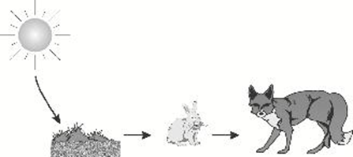
Milestone Review
GPS
13. Use the picture below to answer this
question
What is the energy source in this food chain?
A
the grass
C
the Sun
the fox
the soil
B
D

Slide 15
Milestone Review
GPS
14. A town uses herbicides to control weeds
along the streets. Some of the herbicides
washed into a pond during a rainstorm and
killed all of the algae. What will happen now that
there are no algae in the pond ecosystem?
A
The fish population that fed on the algae will
decrease.
There will be more oxygen in the water for
the fish to breathe.
B
C
Fish that fed on the algae will have to eat
other fish for energy.
Fish that fed on the algae will have to eat
other fish for energy.
D

Slide 16
Milestone Review
GPS
15. The whippoorwill is a bird that is colored
so that it is very difficult to see when it is
perched on a tree limb. Which term
describes this kind of adaptation?
A
aggressive
C
protective
selective
inventive
B
D

Slide 17
Milestone Review
GPS
16. A camel can travel many days without
water. Camels usually live in places with
A
very little rainfall.
B
very little sunshine
C
many lakes.
many plants.
D

Slide 18
Milestone Review
GPS
17. Which animal would be protected in its
environment because of its coloration?
A
a cardinal perched in a tree
B
a red fox walking through an open field
C
a zebra standing at the edge of a lake
a deer's fawn lying on the forest floor
D

Slide 19
Milestone Review
GPS
18. The role of the producer in any community
is to
A
produce space.
B
produce nutrients.
C
produce carbon dioxide
produce food.
D

Slide 20
Milestone Review
GPS
19. Life on Earth is primarily dependent on
energy from
A
the Sun
B
the soil
C
the wind
ocean currents.
D

Slide 21
Milestone Review
GPS
20. Jan is doing an experiment to see how tall
plants grow in different soil. She knows she
needs to keep most things the same from
one trial to the next. Why should she keep
MOST things the same in an experiment?
A
to know what made the plants grow different
heights
B
to use many plants in the experiment
C
to change the height of the plants
D
to grow more plants.

