Slide 1
A Review of Light
By Paul Curcione

Slide 2
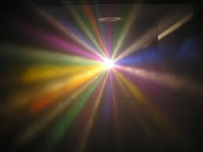
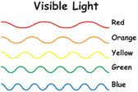
Characteristics of Light
Light is e_____________
You can ___________
Travels in a __________ line
Also travels in w____s

Slide 3
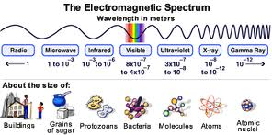
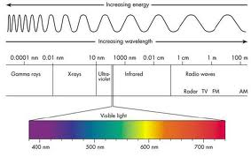
Electromagnetic Spectrum
The Sun gives off s_____ different kinds of energy in waves.
Visible light is light you can________
Radio waves have the ___________ waves
Gamma rays have the __________
Wavelengths
Be careful, don’t let _________ _________ rays burn you.

Slide 4
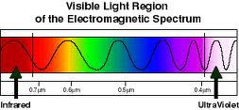
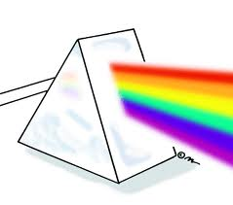
Visible light
ROY G BIV
What instrument proves ROY G BIV?______
Red has the ____________ wavelengths
Violet has the ____________
wavelengths

Slide 5
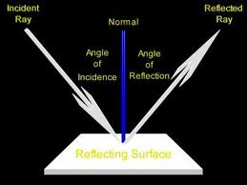
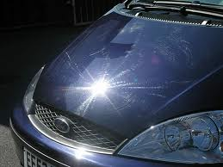
Reflected Light
Light that b_______________ off of a material is reflected
What kind of surfaces are used for this to happen?
Shiny smooth surfaces
What tool is used to prove this? ______________ (see next slide for answer)

Slide 6
The mirror

Slide 7
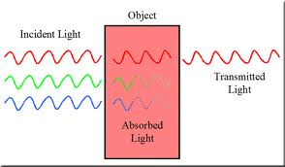
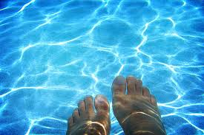
Transmitted light
When light p____________ through a material
What kind of materials allow for this to happen?
Air, _______, _____

Slide 8
Absorbed Light
Light that is NOT ________ or ___________ is absorbed.
Materials take in light and change it to what kind of energy?_____
Dark colors absorb light (wear in what season?
Light colors reflect light (wear in what season?)

Slide 9
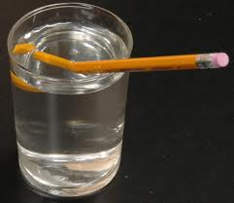
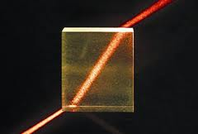
Refraction
B________ of light
Light changes speed when passing through different materials?
What demonstration proves this?
What is another word for refraction?

Slide 10
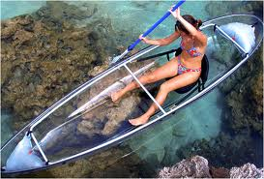
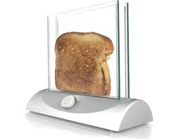
Transparent materials
Are materials that allow for _____ or _________of the light to pass through
Some examples are….
______________, ______, __________
When you see through these materials the object looks C_______

Slide 11
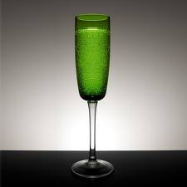
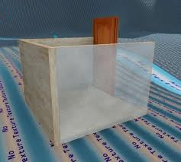
Translucent Materials
Scatters light
Objects appear B____, not clear
S____ light goes through
Examples are:
________, frosted ______ or _________ lightbulbs

Slide 12
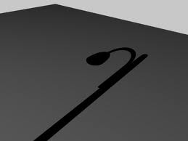
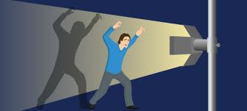
Opaque materials
Does not let any light pass through.
It absorbs or reflects all the light
Opaque objects makes __________
Examples are: book, you, aluminum foil

Slide 13
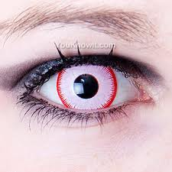
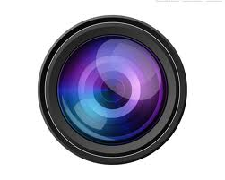
Lens
Recall that refraction means the ________________ of light
A clear material with at least one _____________ surface
How light bends depends on the shape of the lens

Slide 14
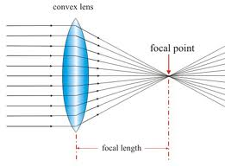
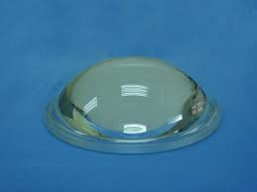
Convex lens
Thicker in the ____________
It bends light i__________
Looking through this lens makes objects look _______
Helps people see close up.
Examples are:
Telescope,
binoculars,
magnifying glass
Farsighted people - glasses

Slide 15
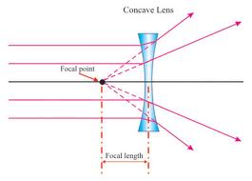
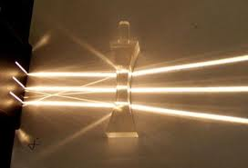
Concave lens
Thicker at the ____________ and skinnier in the _________
A concave lens causes light to bend __________________
Looking through this lens makes objects look ________
Helps people see father away better.
Examples are:
Side mirror on car
Nearsighted people - glasses

Slide 16
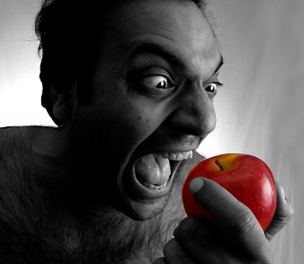
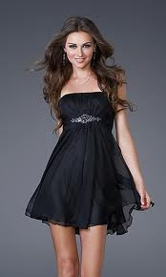
Seeing color
Why does a lemon or a banana look yellow? Why does an apple look red? Why does the grass look green?
These colors are not a_______, but rather these colors are r ______d to our eyes.
An object that looks black a_____ most of the colors of light.
An object that looks white r________s most of the colors of light.

Slide 17


The End
If you liked this PowerPoint, give Mr. C. a thumbs up?

