Slide 1
Animal Adaptations
By Paul Curcione

Slide 2
Animal Adaptations
https://www.youtube.com/watch?v=yY4NNxka_to
https://www.youtube.com/watch?v=fRX2JtKFUzk

Slide 3
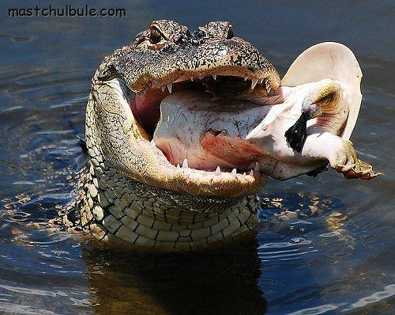
Eat or be eaten!
Guess who is the predator and who is the prey?

Slide 4
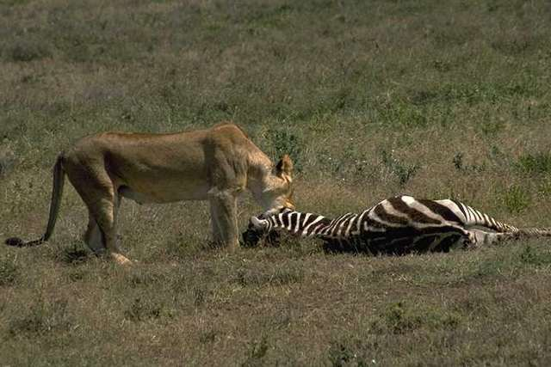
Predator-prey page 2

Slide 5
Predator-Prey page 3
I guess God didn’t hear my prey-ers!

Slide 6
Adapt or Die!

Slide 7
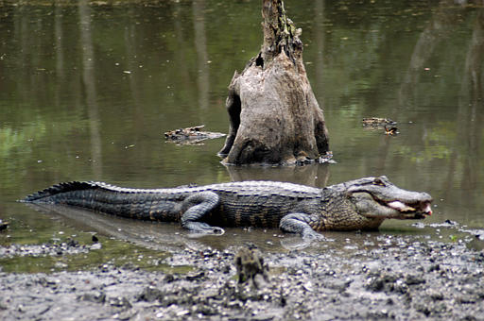
Animal Adaptations page 2
Do you know how I adapt? Hint: This helps me hide from you?
How does the camel adapt to climate?

Slide 8
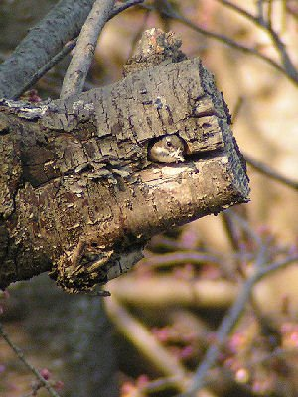
Camouflage
Peek a boo! I see you!
Def: Concealment by blending in or protective coloring.

Slide 9
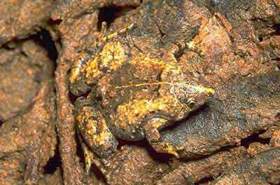
Camouflage Page 2
Can you see me now?
What other animals use camouflage to help them survive?

Slide 10
Camouflage page 3
Please don’t hate just because I eat meat. You are no different.

Slide 11
Animals using camouflage
http://www.boredpanda.com/animal-camouflage/

Slide 12
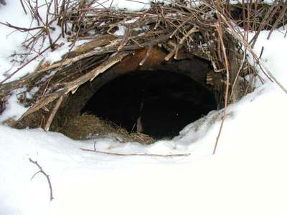
Hibernation keeps us alive too
Can’t find food, so might as well go to……
Def: To be in an inactive or dormant state or period.

Slide 13
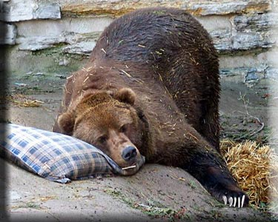
Hibernation page 2
What other animals hibernate?

Slide 14
Animals that hibernate
http://www.earthrangers.com/wildwire/top-10/top-ten-hibernating-animals/

Slide 15
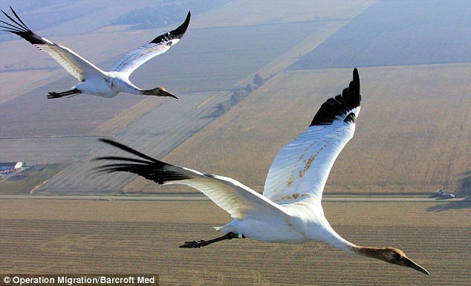
Migration also keeps us alive
I don’t like cold, so…..time to do what?____
Def: To change location periodically,

Slide 16
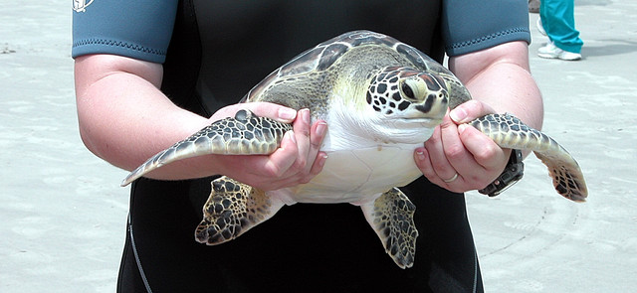
Migration page 2
Let me go; I gotta move too!
Besides rich older people, who else migrates to Florida?

Slide 17
Animals that migrate
http://www.kidsdiscover.com/spotlight/animal-migrations-for-kids/#

Slide 18
Mimicry - if I look or sound like you, maybe I won’t get eaten

Slide 19
Examples of Mimicry
http://forums.sherdog.com/forums/f48/top-10-worlds-best-mimicry-animals-new-2429169/
25 Examples of mimicry and camouflage
https://www.youtube.com/watch?v=XpdoDBYuHIA&list=PLMYb_qWwxCko5ABXT1cGiQOUzfe1XJyXv
https://www.youtube.com/watch?v=VjE0Kdfos4Y

Slide 20
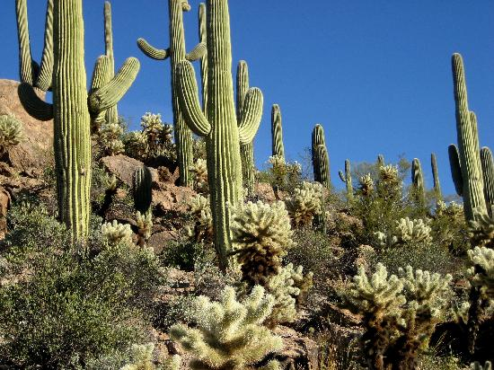
Plants Adapt too
Don’t take my _______; I need it too!

Slide 21
Thanks for watching; Next up….
Survival of the species
Animal Adaptations Song
https://www.youtube.com/watch?v=0N0wVq4nUBU

Slide 22
Survival of a Species
Species - A group of living things that can mate with each other to produce babies
Examples: Bald eagles, lions, humans, dinosaurs , giraffes are all species (giraffes don’t mate with lions, but horses do mate with donkeys!)

Slide 23
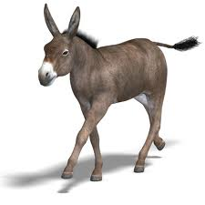
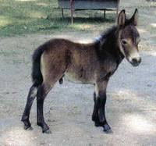
Pop Quiz Time
Let’s see how smart you are!
Question #1: What do you get when a male horse mates with a female donkey? [ Starts with the letter h)
Question #2: What do you get when a male donkey mates with a female horse? [Starts with the letter m]
hinny
mule

Slide 24
Endangered Species
Means I am almost gone!

Slide 25
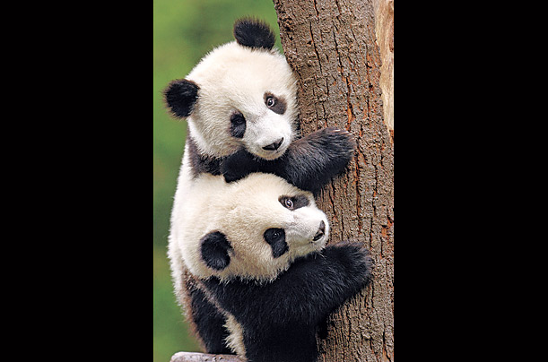
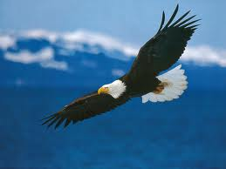
Endangered Species page 2
We are close to becoming extinct (gone)
Do you really want to see me kaput (a goner)?

Slide 26
Panda
http://mrnussbaum.com/mammals-play/giant_panda/

Slide 27
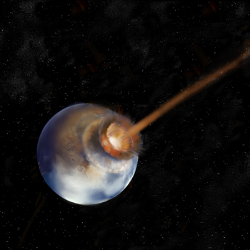
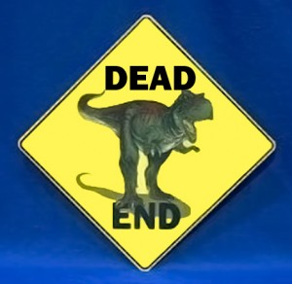
Extinction means gone!
This happened 65 million years ago, and most scientists believe, this caused my exit from the planet.

Slide 28
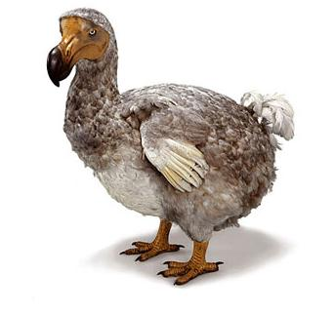
Extinction page 2
The Dodo Bird
I’ll bet you miss me!

Slide 29
Why Dodo became extinct?
They will killed by sailors and animals
The dodo, a flightless forest-dwelling bird of Mauritius, has been extinct since the late 17th cent. Although related to the pigeon, the dodo was larger than the wild turkey.
The dodo laid only one egg at a time, on the ground. European sailors and the pigs and rats they brought to Mauritius slaughtered the birds and destroyed its eggs, and it became extinct in roughly 50 years.

Slide 30
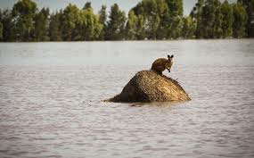
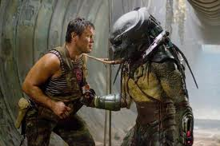
What causes Extinction?
1. Climates change
2. Natural disasters like floods, fires
3. New predators come in
4. New species competing for same food
And……..

Slide 31
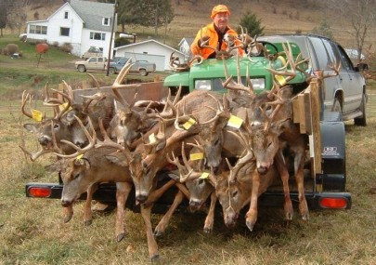
Humans can cause extinction too
1. Over-Hunting

Slide 32
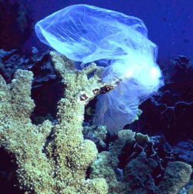
Humans kill page 2
Wastes and Pollution in water and air
Plastic kills!

Slide 33
Humans kill page 3
Water pollution keeps me from breathing you know!

Slide 34
Endangered Species
http://www.kidsplanet.org/factsheets/map.html

Slide 35
Quiz time
1. What does “endangered” mean?
2. What does “extinction” mean?
3. Name two ways that cause extinction of an animal?
4. What can humans do to prevent extinction of an animal?

Slide 36
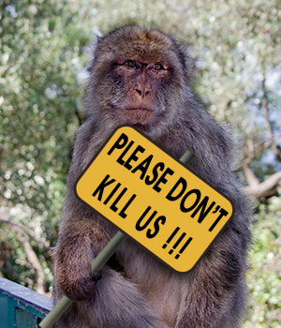
The End
I really want to continue to love you guys!

