Slide 1
4th Grade
Milestone Review
CFA #3

Slide 2
Milestone Review
GPS
Ruth sat on the floor and played with a wooden spoon and a pan. If Ruth hit the pan with the spoon, it would sound most like a
A. car horn.
B. crying baby.
C. drum.
D. train whistle.

Slide 3
Milestone Review
GPS
2. The Sun, a lightbulb, and a candle
all give off light. How does the light
from these things feel?
A. dry
B. wet
C. cool
D. warm.

Slide 4
Milestone Review
GPS
3. Sound waves are produced by
A. gravity.
B. heat.
C. vibration.
D. light.

Slide 5
Milestone Review
GPS
4. Jane hears a fire truck siren that
does not change in pitch or
loudness. The fire truck is
A. leaving the station.
B. parked at the station.
C. passing by the station.
D. coming toward the station.

Slide 6
Milestone Review
GPS
5. A strong source of light with one
wavelength traveling in only one
direction is called
A. infrared light.
B. ultraviolet light.
C. a laser.
D. fiber optic light

Slide 7
Milestone Review
GPS
6. ALL sounds are caused by
A. the vibration of objects or materials.
B. sudden changes in temperature.
C. air currents.
D. electrical currents in air.

Slide 8
Milestone Review
GPS
7. A compass can help you find your
direction by using
A. static electricity.
B. magnetism.
C. chemicals.
D. photoelectric cells.

Slide 9
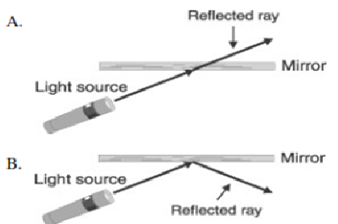
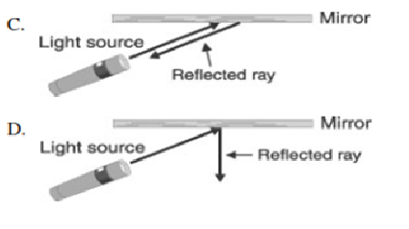
Milestone Review
GPS
8. Which picture shows the correct
reflected

Slide 10
Milestone Review
GPS
9. A flute makes a high−pitched sound.
Which also makes a high−pitched
sound?
A. cow
B. drum
C. thunder
D. whistle

Slide 11
Milestone Review
GPS
Which would make the softest
sound?
A. balloon popping
B. hammer hitting a nail
C. eraser hitting a chalkboard
D. metal rod hitting a musical triangle

Slide 12
Milestone Review
GPS
11. In old movies, people sometimes
put their ear on a railroad track to
see if a train is coming. This works
because the iron rail
A. is heated by friction.
B. carries the sound better than air.
C. is cooler than air.
D. is connected directly to the train

Slide 13
Milestone Review
GPS
12. Suppose four spaceships are
launched from Earth today. It would
take longest for a spaceship to get
to which location?
A. Pluto C. Jupiter
B. the moon D. Mercury

Slide 14
Milestone Review
GPS
13. Which objects works by reflecting
light?
A. mirror
B. burning candle
C. light bulb
D. hand lens

Slide 15
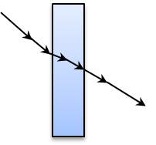
Milestone Review
GPS
14. In the diagram below, arrows show
the path of light. Which of these
processes does the diagram
illustrate?
A. reflection
B. refraction
C. scattering
D. absorption

Slide 16
Milestone Review
GPS
15. A glass of cold lemonade was
taken from the refrigerator and set
on the table. Soon there were little
drops of water on the outside of
the glass. Where did the water
come from?
A. The water came from the air outside glass.
B. The water came through the glass.
Ice in the glass melted and the
lemonade in the glass overflowed.
D. Nobody knows where the water came from.

Slide 17
Milestone Review
GPS
16. We see colors of objects because
they
A. absorb and reflect light.
B. transmit and reflect light.
C. refract and reflect light.
D. absorb and refract light.

