Slide 1
4th Grade
Milestone Review
CFA #9

Slide 2
Milestone Review
GPS
In any community, which group includes the largest number of living things?
A
herbivores
B
consumers
C
predator
producers
D

Slide 3
Milestone Review
GPS
2. Which adaptation is LEAST useful for
animals that live in the tundra?
A
thick fur
long, thin legs
B
C
white body color
hibernating
D

Slide 4
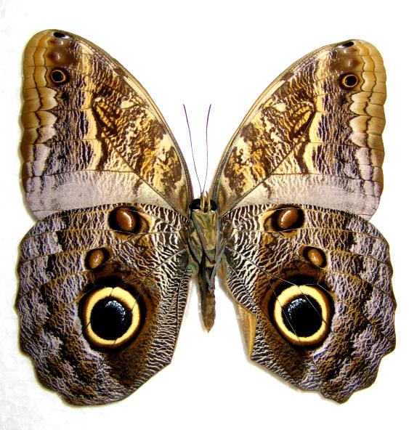
Milestone Review
GPS
3. The pattern on this butterfly looks
like an owl’s eyes.
This is an example of
A
extinction
camouflage
B
C
hibernation
mimicry
D

Slide 5
Milestone Review
GPS
4. Which of these changes would most
harm the organisms of a pond
community?
A
the death of the largest fish in the pond
several days of heavy rain
B
C
people draining much of the pond’s water
the arrival of winter
D

Slide 6
Milestone Review
GPS
5. In the 1800s, humans hunted huge
numbers of American bison. The
species almost became
exported
endangered
A
C
migrated
extinct
B
D

Slide 7
Milestone Review
GPS
6. In a meadow ecosystem, a population
of rabbits increases. What populations
are most likely to increase as a result?
A
foxes, hawks, and other predators of the rabbits
reproduce
B
C
rabbits that lives elsewhere
worms that live in the meadow soil
D

Slide 8
Milestone Review
GPS
7. When does a chipmunk hibernate?
A
over winter
over summer
B
C
during raining weather
when prey are scarce
D

Slide 9
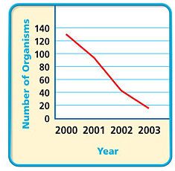
Milestone Review
GPS
8. The line graph shows the population over time of
animal species. What event could explain the
data?
A
The animals were overhunted and became endanger
.
B
The animals migrated every spring.
C
The animals hibernated every winter.
The animals were extinct in 2003
D

Slide 10
Milestone Review
GPS
9. A frog with which adaptation is most
likely to be poisonous?
A
camouflage
slimy skin
B
C
strong legs
bright body color
D

Slide 11
Milestone Review
GPS
10. Fossils provide clues to the lives of
A
extinct species of long ago.
all extinct species
B
C
endangered species.
animals only, not plants.
D

Slide 12
Milestone Review
GPS
11. Camouflage may help an animal
hide from
A
plants to get washed away or destroyed
prey only.
B
C
predators and prey.
small animals only.
D

Slide 13
Milestone Review
GPS
12. Which animal is extinct?
A
lion
bald eagle
B
C
house cat
T-rex
D

Slide 14
Milestone Review
GPS
13. What is a species?
A
the place where an animal or plant lives
something a living thing does over and over again
B
C
a group of living things that can mate with one
another
the remains or trace of an organism that lived long
ago
D

Slide 15
Milestone Review
GPS
14. What must all living things do in order for
their species to survive?
A
become endangered
reproduce
B
C
become fossils
hibernate
D

Slide 16
Milestone Review
GPS
15. Which statement is TRUE?
A
Only human activities cause species to become
extinct
B
Only natural events cause species to become
extinct.
C
Both natural events and human activities can
cause species to become extinct.
No species tat are alive today will become extinct.
D

Slide 17
Milestone Review
GPS
16. Which describes a group of living things
of the same kind living in the same area?
A
ecosystem
B
environment
C
habitat
population
D

Slide 18
Milestone Review
GPS
17. Which is a group of animals extinct?
A
when few of its egg hatch
B
when there is a flood
C
When all members of the group have died
No when very few members of the group are alive
D

Slide 19
Milestone Review
GPS
18. Which does an eagle’s beak help it do?
A
run from predators
B
catch its prey
C
hide from predators
migrate
D

Slide 20
Milestone Review
GPS
19. Snakes eat frogs. Frogs eat crickets.
What will MOST LIKELY happen in a swamp
if many of the frogs die during a drought?
A
The frog population will increase
B
The cricket population will increase.
C
The snake population will increase.
The snakes will learn to eat crickets.
D

Slide 21
Milestone Review
GPS
20. Which is an effect of land development?
A
Natural habitats get larger
B
It gets easier for most living things to find
resources they need.
C
Resources living things need are removed from the
area.
D
Drought occur.

Slide 22
Milestone Review
GPS
21. Flooding can cause?
A
plants to get washed away or destroyed.
B
plants to dry up and die.
C
predators to stop hunting prey.
D
animals to get thirsty and move away

Slide 23
Milestone Review
GPS
22. Which adaptation helps a giraffe hide from
grassland predators?
A
long neck.
B
long legs
C
spotted coat
D
strong lips

Slide 24
Milestone Review
GPS
23. Which event caused the Carolina
parakeet to become extinct?
A
a climate changing from warm to cold
B
an object from space crashing into Earth
C
the hunting of parakeets by people
D
the use of the pollutant DDT by people

Slide 25
Milestone Review
GPS
24. Which is an effect that clearing land to
grow crops and raise farm animals has on
living things?
A
Their natural habitat gets smaller.
B
Their natural habitat gets larger
C
They are no longer hunted by predators
D
They change from prey to predators.

Slide 26
Milestone Review
GPS
25. A screw and a wheel chair ramp are both
examples of
A
Wheel and axle
B
a pulley
C
Inclined plane
D
a lever

